Slide 1

Operating systems
I/O Management, System Protection and Security and Case Study
Venkatesh Prasad
Department of Computer Science
Notes:
1

Slide 2
Operating systems
Case Study – Windows File System
Venkatesh Prasad
Department of Computer Science
Notes:
Brief explanation of Windows File system
2

Slide 3
OPERATING SYSTEMS
Slides Credits for all PPTs of this course
The slides/diagrams in this course are an adaptation, combination, and enhancement of material from the following resources and persons:
Slides of Operating System Concepts, Abraham Silberschatz, Peter Baer Galvin, Greg Gagne - 9th edition 2013 and some slides from 10th edition 2018
Some conceptual text and diagram from Operating Systems - Internals and Design Principles, William Stallings, 9th edition 2018
Some presentation transcripts from A. Frank – P. Weisberg
Some conceptual text from Operating Systems: Three Easy Pieces, Remzi Arpaci-Dusseau, Andrea Arpaci Dusseau
Internet source

Slide 4
OPERATING SYSTEMS
File System - Basics
FAT file system is still used for portability on other systems such as cameras, flash memory and external disks
FAT file system does not restrict file access to authorized users.
NTFS uses ACLs to control access to individual files and supports encryption.
NTFS supports data recovery, fault tolerance, very large files and file systems, journaling, file compression, etc
A file in NTFS is not a simple byte stream, as in MS-DOS or UNIX, rather, it is a structured object consisting of attributes
Attributes like file name, creation time, descriptor, ACLs, etc
Notes:
4

Slide 5
OPERATING SYSTEMS
File System – Basics (Cont.)
The fundamental structure of Windows file system (NTFS) is a volume
Created by the disk administrator utility
Based on a logical disk partition
May occupy a portions of a disk, an entire disk, or span across several disks
All metadata, such as information about the volume, is stored in a regular file
NTFS uses clusters as the underlying unit of disk allocation
A cluster is a number of disk sectors that is a power of two
The default cluster size is based on the volume size - 4 KB for volumes > 2 GB
Because the cluster size is smaller than for the 16-bit FAT file system, the amount of internal fragmentation is reduced
Notes:
5

Slide 6
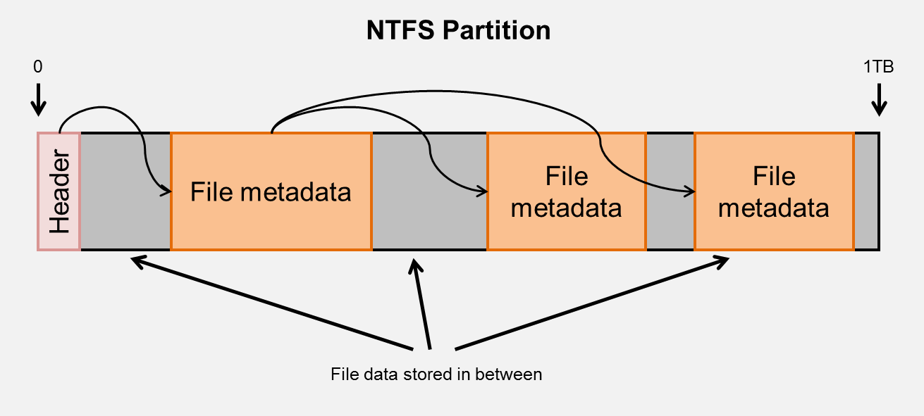
OPERATING SYSTEMS
File System — NTFS (Cont.)
NTFS, the filesystem used by all modern versions of Windows
Instead of storing file metadata in tables scattered across the partition (usually to optimise hard disk seek times going from file metadata to actual file data), NTFS stores all the file metadata in a few large contiguous blocks.
These blocks are collectively known as the MFT (master file table).
Helps to quickly scan all the files in the partition to get each file's associated metadata. Instead of recursing through each directory manually and enumerating contents (like when computing summary statistics for directories)
Notes:
The metadata for a given file typically includes its filename, its size, and pointers to where the contents of the file can be found in the partition. If the file is a directory, this will also include pointers to where the metadata for its contents can be found in the MFT.
6

Slide 7
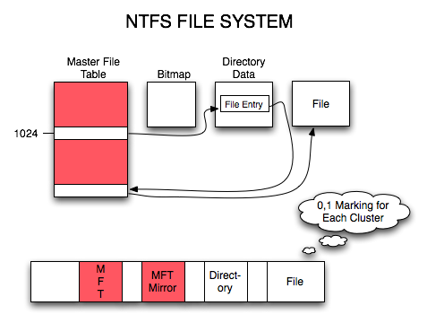
OPERATING SYSTEMS
File System — NTFS (Cont.)
Every file in NTFS is described by one or more records in an array stored in a special file called the Master File Table (MFT)
Windows puts the Master File Table at the front of the drive, with a mirror file in the middle of the drive with only the first directory containing critical information.
The Bitmap is used to determine allocation/nonallocation of clusters.
Notes:
7

Slide 8
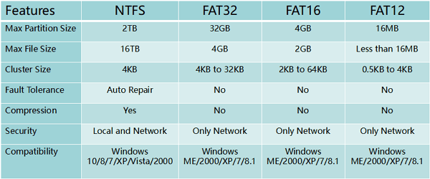
OPERATING SYSTEMS
File System — NTFS vs FAT
Notes:
8

Slide 9
OPERATING SYSTEMS
File System — Internal Layout
NTFS uses logical cluster numbers (LCNs) as disk addresses
Physical disk offset in bytes = LCN x cluster size
A file in NTFS is not a simple byte stream, as in MS-DOS or UNIX, rather, it is a structured object consisting of attributes
Each file on an NTFS volume has a unique ID called a file reference.
64-bit quantity that consists of a 48-bit file number and a 16-bit sequence number
Sequence number is incremented every time an MFT entry is reused, can be used to perform internal consistency checks (to catch a stale reference to a deleted file)
The NTFS name space is organized by a hierarchy of directories; the index root contains the top level of the B+ tree
B+ tree is an extension of the B tree
Notes:
The difference in B+ tree and B tree is that in B tree the keys and records can be stored as internal as well as leaf nodes whereas in B+ trees, the records are stored as leaf nodes and the keys are stored only in internal nodes
9

Slide 10
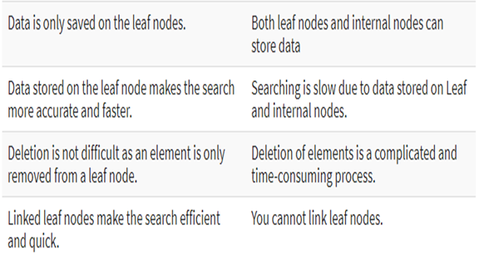
OPERATING SYSTEMS
File System—B+ Tree vs. B Tree
The drawback of B-tree used for indexing, however is that it stores the data pointer (a pointer to the disk file block containing the key value), corresponding to a particular key value, along with that key value in the node of a B-tree. This technique, greatly reduces the number of entries that can be packed into a node of a B-tree, thereby contributing to the increase in the number of levels in the B-tree, hence increasing the search time of a record.
B+ tree eliminates the above drawback by storing data pointers only at the leaf nodes of the tree.
Notes:
10

Slide 11
OPERATING SYSTEMS
File System - Recovery
All file system data structure updates are performed inside transactions that are logged.
Before a data structure is altered, the transaction writes a log record that contains redo and undo information.
After the data structure has been changed, a commit record is written to the log to signify that the transaction succeeded.
After a crash, the file system data structures can be restored to a consistent state by processing the log records.
Notes:
11

Slide 12
OPERATING SYSTEMS
File System – Recovery (Cont.)
This scheme does not guarantee that all the user file data can be recovered after a crash, just that the file system data structures (the metadata files) are undamaged and reflect some consistent state prior to the crash.
The log is stored in the third metadata file at the beginning of the volume.
The logging functionality is provided by the log-file service which keeps track of free space in the log file
halts new I/O operations in case free space gets too low
Notes:
12

Slide 13
OPERATING SYSTEMS
File System - Security
Security of an NTFS volume is derived from the Windows object model.
Each file object has a security descriptor attribute stored in this MFT record.
This attribute contains the access token of the owner of the file, and an access control list that states the access privileges that are granted to each user that has access to the file.
Notes:
13

Slide 14
OPERATING SYSTEMS
Volume Management and Fault Tolerance
FtDisk, the fault tolerant disk driver provides several ways to combine multiple SCSI disk drives into one logical volume
Logically concatenate multiple disks to form a large logical volume, a volume set
Interleave multiple physical partitions in round-robin fashion to form a stripe set (also called RAID level 0, or “disk striping”)
FtDisk uses a stripe size of 64 KB – 1st 64 KB of the logical volume are stored in the 1st physical partition, 2nd 64 KB in the 2nd physical partition, and so on
Windows also supports RAID level 1 (mirroring) and RAID level 5 (stripe set with parity)
Disk mirroring, or RAID level 1, is a robust scheme that uses a mirror set — two equally sized partitions on tow disks with identical data contents
To deal with disk sectors that go bad, FtDisk, uses a hardware technique called sector sparing (i.e. formatting a disk drive leaves extra sectors unmapped as spares) and NTFS uses a software technique called cluster remapping (i.e changes the pointers in the MFT from bad block to unallocated block)
Notes:
14

Slide 15
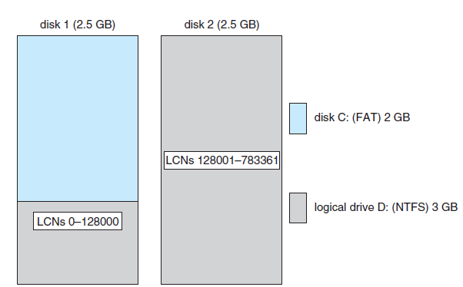
OPERATING SYSTEMS
Volume Set On Two Drives
Logical volume or a volume set can consist of up to 32 physical partitions
A volume set can be extended by extending the bitmap metadata on the NTFS volume to cover the newly added space (bitmap contains information about free or used data blocks/clusters on a volume)
Fig 1==> 128000 x 4 KB = 0.5 GB
Fig 2 => 655360 x 4 KB = 2.5 GB
Notes:
15

Slide 16
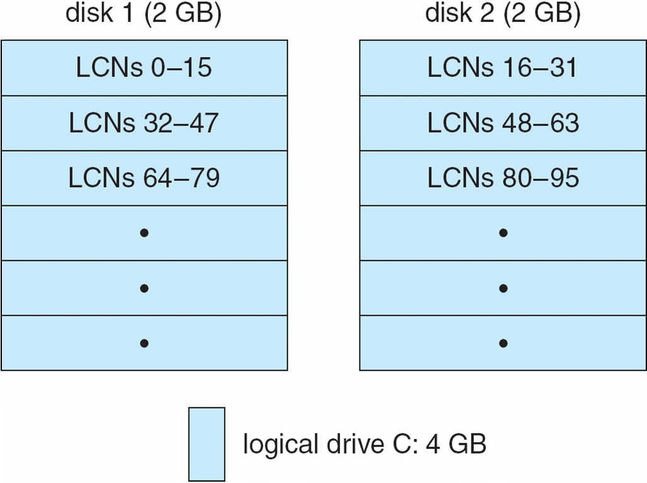
OPERATING SYSTEMS
Stripe Set on Two Drives
Notes:
16

Slide 17
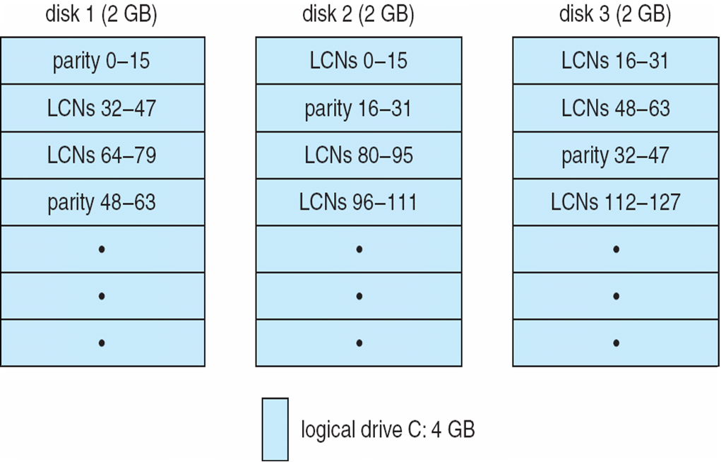
OPERATING SYSTEMS
Stripe Set With Parity on Three Drives
Notes:
17

Slide 18
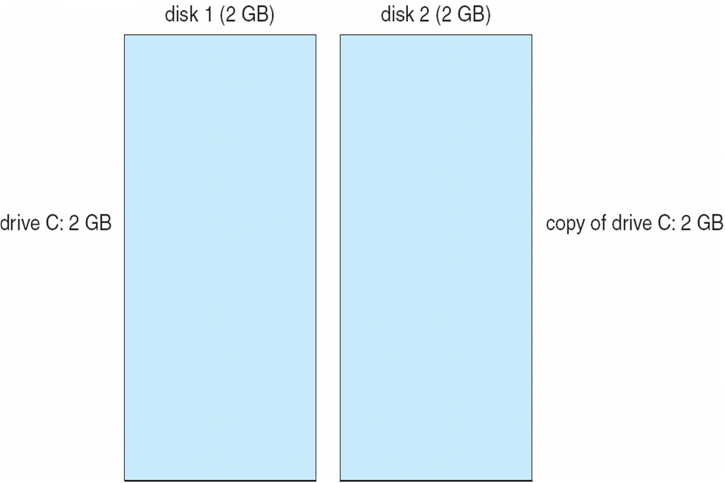
OPERATING SYSTEMS
Mirror Set on Two Drives
Notes:
18

Slide 19
OPERATING SYSTEMS
File System — Compression
To compress a file, NTFS divides the file’s data into compression units, which are blocks of 16 contiguous clusters.
To improve performance when reading contiguous compression units, NTFS prefetches and decompresses ahead of the application requests.
For sparse files, NTFS uses another technique to save space.
Clusters that contain all zeros (ie. never been written) are not actually allocated or stored on disk.
Instead, gaps are left in the sequence of virtual cluster numbers stored in the MFT entry for the file.
When reading a file, if a gap in the virtual cluster numbers is found, NTFS just zero-fills that portion of the caller’s buffer.
Notes:
19

Slide 20
OPERATING SYSTEMS
File System (Contd.)
Mount Points, Symbolic links, Hard Links
Hard links: A single file has an entry in more than one directory of the same volume
NTFS Journal – describes all changes that have been made to the file system.
Used by services such as User-mode (to identify what files have changed), search indexer (to re-index files) and file-replication (to replicate files across the network)
Snapshots to create a shadow copy of volume for backup (and recovery of files if accidentally deleted)
Notes:
20

Slide 21

THANK YOU
Venkatesh Prasad
Department of Computer Science Engineering
venkateshprasad@pes.edu

